Slide 1
Hardware and Components Basics Understanding of Hardware and its components
A+ Day 1 Assignment
Pratham Baria

Slide 2

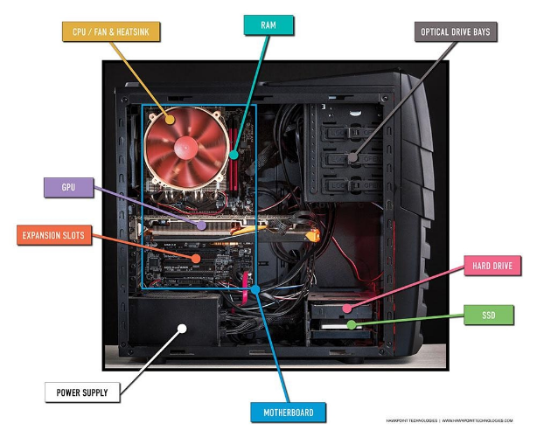
Task 1
Desktop PC Internal Hardware Diagram
Labeled Internal Components:
•
Motherboard: The central circuit board that connects all hardware.
•
CPU & Heatsink Fan: Central processor kept cool by the fan on top.
•
RAM Slots: High-speed memory sticks installed next to the cooler.
•
GPU (Graphics Card): Dedicated card installed in the PCIe slot.
•
Storage (SSD & HDD): Solid state drive and mechanical hard drive bays.
•
Power Supply (PSU): Supplies electrical power to every component.

Slide 3
Task 2
Difference Between HDD and SSD Storage
Feature | Hard Disk Drive (HDD) | Solid State Drive (SSD)
Speed | Slow (around 100 to 150 MB/s because it has spinning magnetic disks). | Very fast (500 MB/s for SATA, up to 3500+ MB/s for NVMe drives).
Durability | Low shock resistance. Drops or shakes while running can damage the read head. | High durability. No moving parts inside, so it survives drops and shocks easily.
Boot Time | Slow boot time (typically 40 to 60+ seconds to load Windows). | Instant boot time (usually boots Windows in under 10 to 15 seconds).
Where It Is Used | Bulk storage, external backup drives, CCTV setups, and budget file storage. | Primary operating system drive, gaming PCs, and all modern laptops.

Slide 4
Task 3
Role of CPU, RAM, and GPU in PUBG / Free Fire
1. CPU (Central Processing Unit)
The CPU runs the game engine, handles hit detection, bullet trajectories, and communicates with the online game server. It also coordinates instructions so the graphics card knows what to draw.
2. RAM (Random Access Memory)
RAM temporarily holds all active map data, character models, and weapon sounds so the PC can access them instantly. Having enough RAM stops the game from freezing when moving across open map zones.
3. GPU (Graphics Processing Unit)
The GPU calculates and renders all the 3D graphics, shadows, smoke, and textures on the monitor. It determines the frames per second (FPS), keeping gun fights and aiming smooth.

Slide 5
Task 4
Hardware Upgrade Plan to Run FIFA Smoothly
1. Dedicated Graphics Card (GPU)
4. NVMe SSD & 550W PSU
Upgrade: GTX 1660 Super / RTX 3060 (6GB to 8GB VRAM).
Why: FIFA uses the Frostbite engine. A good GPU is needed to render pitch turf, stadium crowds, and close-up cutscenes without FPS drops.
Upgrade: 512 gb SSD and a reliable 550W PSU (Power Supply Unit).
Why: The SSD cuts game launch and match load times to seconds, while the PSU supplies clean power for the upgraded GPU.
2. Processor (CPU)
Upgrade: 6-Core CPU (Intel Core i5 or AMD Ryzen 5).
Why: Handles the player AI logic for all 22 players on the pitch and real-time ball deflections without stuttering.
3. 16 GB Dual-Channel RAM
Upgrade: 2 x 8GB RAM sticks.
Why: Running in dual-channel doubles memory bandwidth and stops background Windows tasks from causing gameplay stutters.

